Slide 1
Young people in policy-making Funding Q and A
Philippa Knott Kos, Policy manager

Slide 2
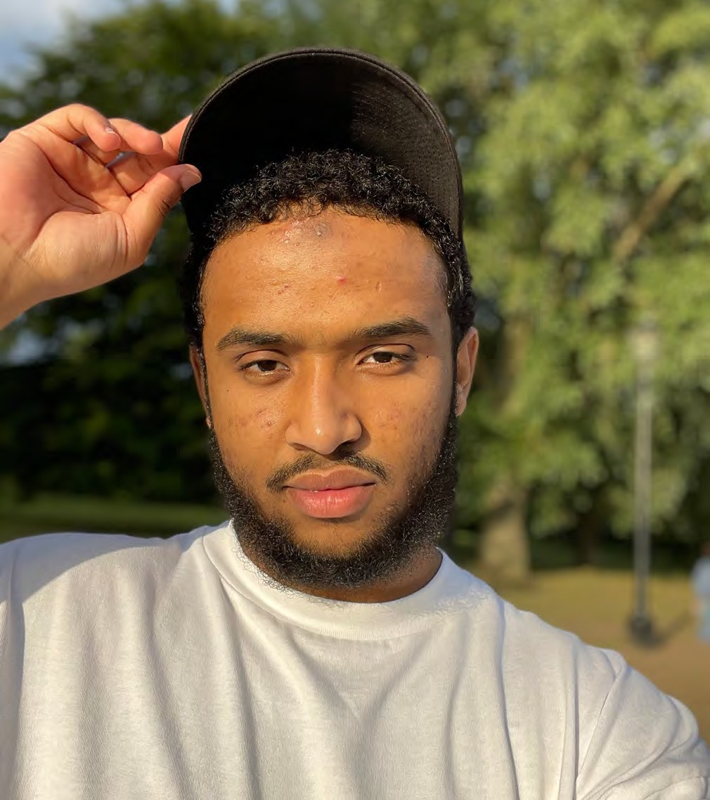
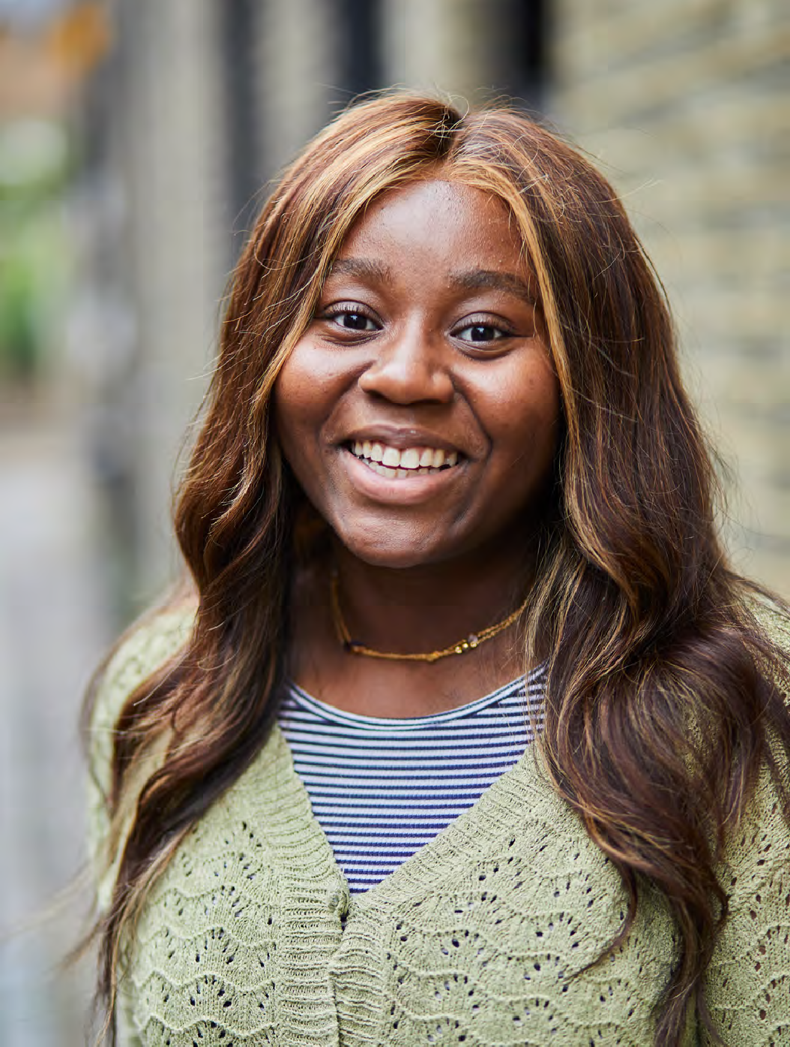
Our mission
To bring lasting change to the lives of young people; investing in them as powerful forces for change and acting upon their right to be heard in pursuit of a fair and just society.

Slide 3
Policy funding at Blagrave
1. Increasing democratic engagement and representation
Contributing funder to the Democracy fund
2. Supporting young people to engage in policy-making
Call-out for proposals
Learning: how young people can most effectively influence
3. Policy work that fights for the needs and rights of young people facing the most disadvantage
Rolling grants programme
Research; advocacy; may take advantage of a moment in time to achieve a change in government policy

Slide 4
Why this call-out?

Slide 5
Priorities
1. Strong model and potential for impact on policy-making, e.g:
Model
Connections
Opportunities
Context
Track record
2. Working with young people most likely to have experienced social injustice and the least likely to be heard, e.g:
Connection to relevant communities
Understanding of young people’s needs and contributions
Understanding of intersectionality and privilege
Opportunities for young people to meaningfully lead

Slide 6
The ‘what’
Deliberative and/or creative processes for developing, informing and advocating for policy recommendations
Peer research and follow-up advocacy
Programmes that allow young people and policy-makers to work side-by-side
Initiatives to support young people from under-represented backgrounds to themselves take up policy-making roles

Slide 7
Eligibility
This funding is for | This funding is not for
Charities and non-profit organisations in England that are supporting young people (aged 16-25) with experience of social injustice to be heard in policy-making processes | Work whose primary objective is to educate young people on democratic processes and engagement, or driving up voter registration/turnout
Work targeting either national or local government policy-making, or the policies of large public bodies such as the police or NHS | Any work that is not compliant with charity law e.g. party political in focus, or aiming to influence the outcomes of an election.
Organisations with the skills to deliver the work alone, or in partnership
Either new or ongoing work

Slide 8
Process
Open for proposals on Thurs 20th January 2022
Online Q and A session at 2pm, Weds 2nd February
Brief for learning partner published by 11th Feb
Deadline for proposals midnight Fri 25th February
Further questions and clarifying conversations: we will set up phonecalls/videocalls as necessary with shortlisted organisations on the 14th, 15th and 16th March
Final decisions made and communicated in early April
Learning partner appointed in April
All funding agreed by end April

Slide 9
Over to you!

Slide 10
Philippa.kos@blagravetrust.org

