Slide 1

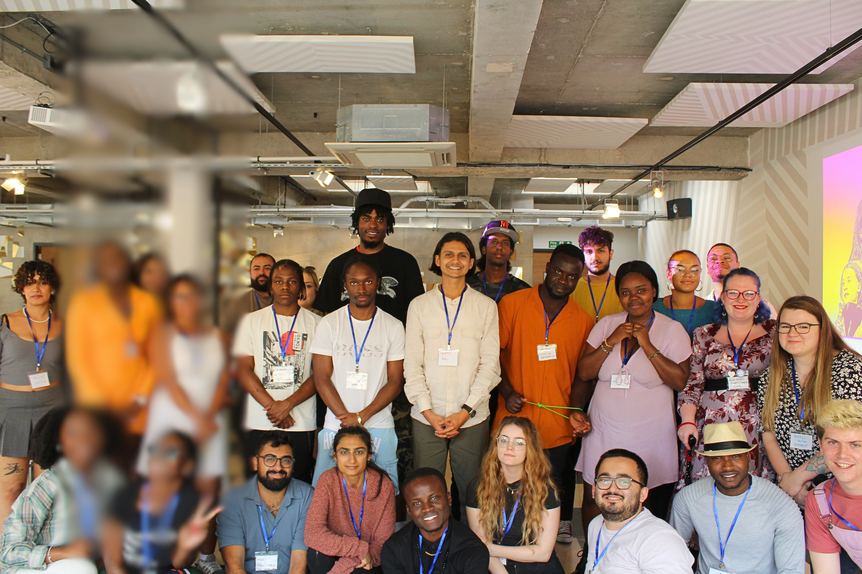


Date:
Aug 13th, 2025
Challenge
and Change
Welcome to our Q&A

Slide 2
HOUSE
KEEPING
We will be recording the Q&A session to upload onto the website for those who are unable to
attend today – if you do not wish to be in the recording, please do feel free to leave camera
off and use the chat function to submit your questions.
Please keep yourself muted until you are asked to speak during the questions
section of the presentation.

Slide 3

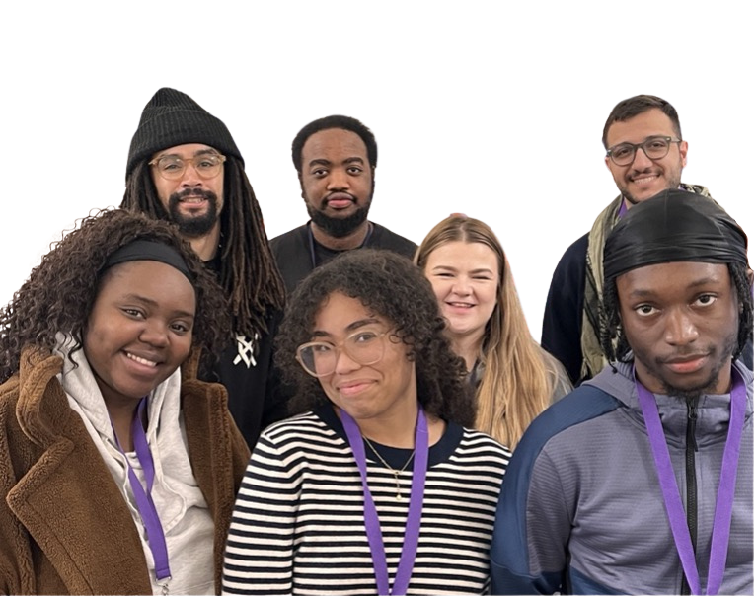

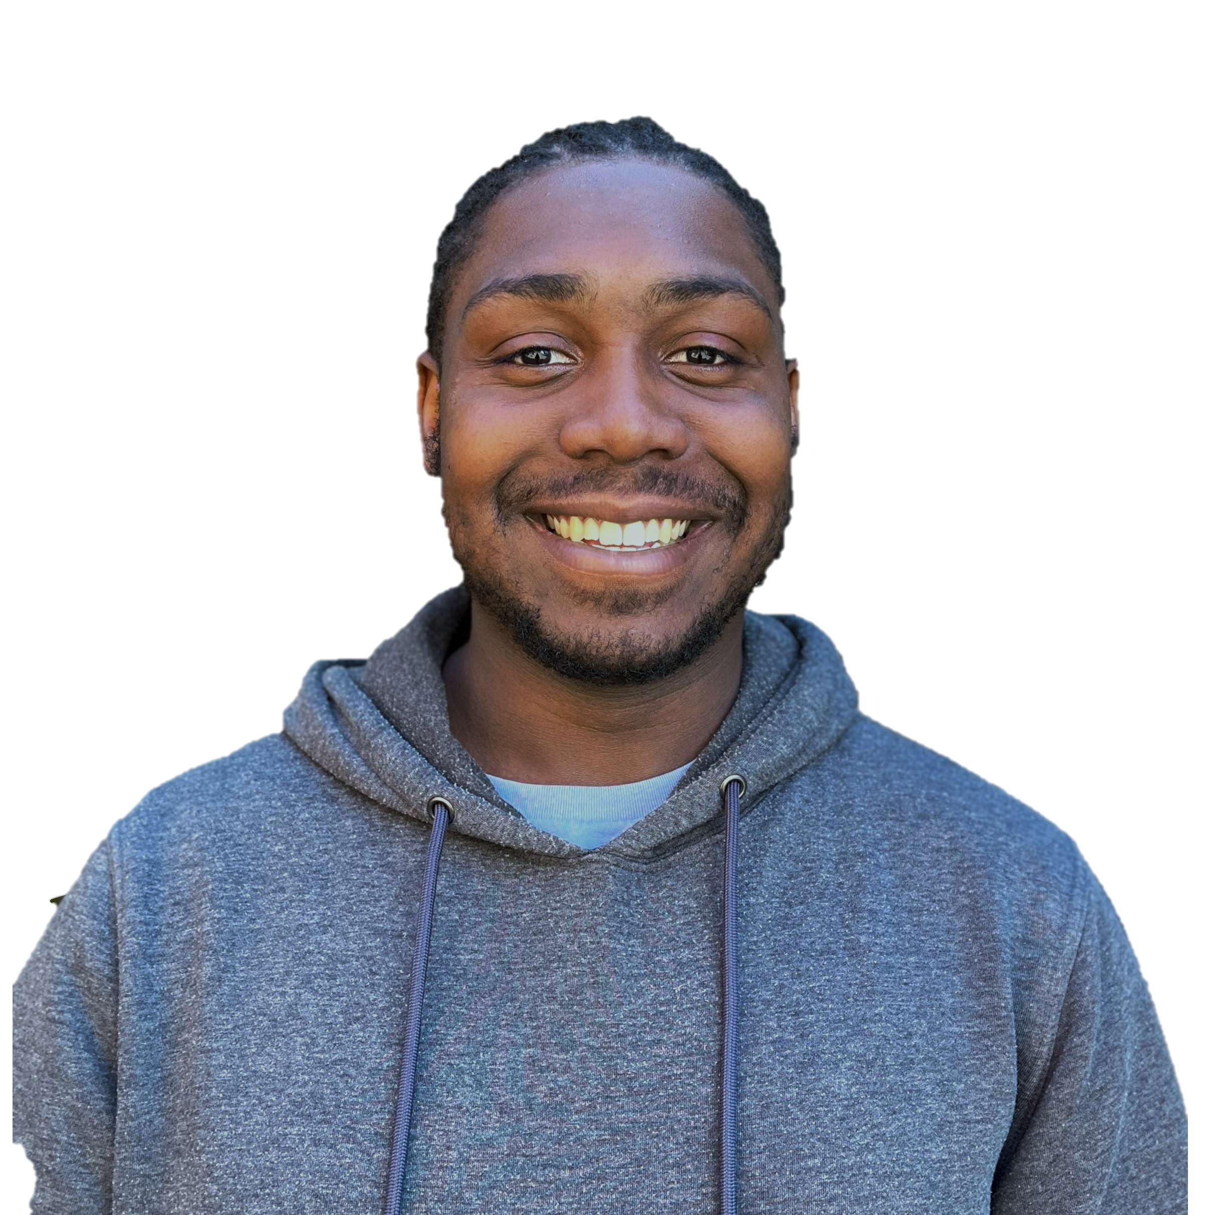
Ryan Dube
(He/Him)
MEET
THE TEAM
Ali Ghaderi
(He/him)
Jhemar Jonas (He/Him)
Rochell Rowe
(She/Her)
Jaden Osei-Bonsu (He/him)
Chrissie Okorie
(she/Her)
Demetri Addison
(He/Him)
Ava James
(She/Her)

Slide 4
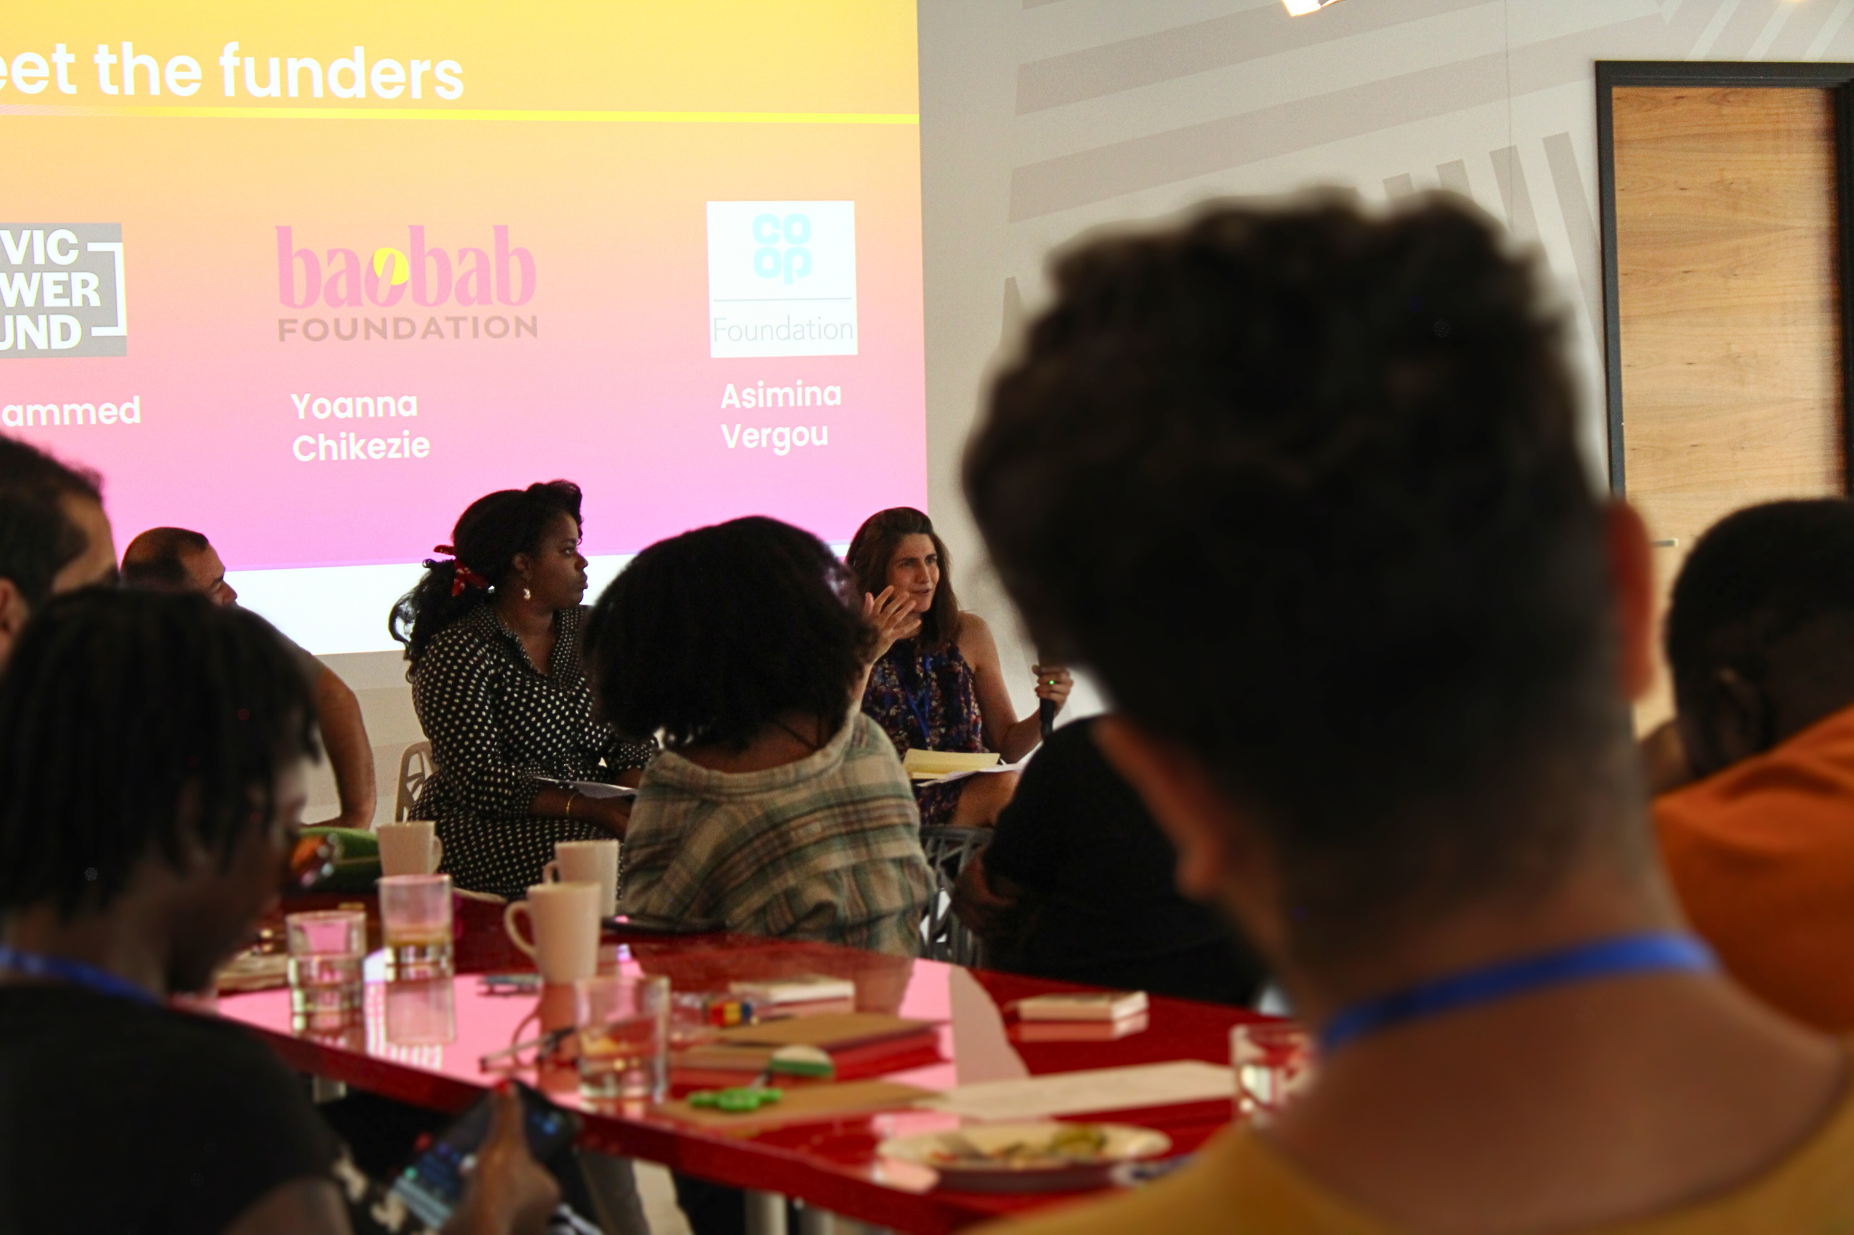
The Blagrave Trust is a registered Charity, endowed in 1981
1981
Blagrave’s
History
In 2009 we sold the estate in Hampshire which was our main endowment. This allowed us to hire staff and deepen the impact we could have in communities (which was in the south east of England most at the time)
2009
If you’d like to hear more about our history, please see our website history page!
In 2014 we decided to focus solely on supporting young people, with a more diverse and younger trustee board and moved our work to being more nationally focused.
2014
In 2020 we made the decision and move to begin investing in young people directly and that’s when Challenge and Change came into existence.
2020

Slide 5







Thank You!
We would like to give a special thanks to The Ellis Campbell Foundation and The Roots and Routes Fund (the Co-op Foundation, the Energy Saving Trust Foundation, OVO Foundation, and
Impatience Earth) for their financial contributions allowing us to grow the programme.

Slide 6
WHAT IS CHALLENGE
AND CHANGE?
Launched in 2020, Challenge and Change was created by and for young people with lived experience of injustice. Every version since has been designed with the leaders it serves. The 2025 edition is no different — co-created by five amazing advisers with support from The Centre for Knowledge Equity and The Blagrave Trust.

Slide 7
This fund exists because we know young people are already leading change —
but often without the
funding or support
they need to grow!
It’s a national program, funding lived experienced leaders across England.

Slide 8



Chrissie Okorie
is building a rebellious
new world.
There’s no such thing as a ‘hard to reach‘child.
You only
need to ask
The Formula.
Not a Trend is
building a new
generation
of antiracists,
one school
at a time.
STORIES OF C&C

Slide 9
Who is C&C for?
Challenge and Change is for you if:
01
02
03
You’re 18–25 years old at point of application, and living in England
You’re using your lived experience to lead change
You’re an individual, or part of a collective or movement

Slide 10
Who is C&C for?
Challenge and Change is for you if:
04
05
You’re already involved in social justice work but lack resources
Ready to make positive lasting change on an issue that affects you and others

Slide 11
Who is C&C for?
As the Challenge and Change team we will be considering the below to build a diverse cohort:
Young people that really care about their community and are using their lived experience to truly create change in their environments and looking to develop their practice
How young people represent themselves – we care about their potential and how they can imagine change happening in their communities.
Young people who may be from rural areas that often get overlooked
Collaboration over competition
Clarity of work, a clear plan of action
Anti-oppressive work that is not at the cost of another person’s freedom
How young people are representing their communities and the tone of voice they
choose to use
A range of locations and themes

Slide 12
Climate Justice
This year we’re also backing Climate Justice.
13 of our grants will be reserved for work on climate justice. For Challenge and Change we define Climate justice as:
Climate justice means repairing the unequal harm caused by climate change — especially for communities who are most affected but least responsible. It’s about ensuring everyone has clean air, access to green spaces, healthy food, space to heal and a voice in shaping their future.
Climate justice recognizes that solutions must be community-led and culturally rooted — not one-size-fits-all. It’s about land justice, food justice, and the right to nature, especially for those historically excluded or harmed.
Examples of climate justice in action:
Campaigning for clean air in polluted neighborhoods
Protecting and reclaiming public land for community use
Supporting Indigenous and local food systems (ways of farming and cooking that existed before colonisation of land)
Taking young people from urban cities on trips to connect with land and culture
Creating space for frontline communities to lead climate solutions
Educating others to challenge harmful systems and mindsets
Climate justice is not just environmental — it’s social, cultural, and deeply human.
Anti-oppressive work that is not at the cot of another person’s freedom
A range of locations and themes

Slide 13
Who is C&C not for?
Exclusions (not eligible):
01
02
03
Non youth led organisations (for this programme, organisations run by those aged 26 and over)
that want to launch work on behalf of a young person or group of young people.
One-off pieces of work (e.g. an art installation) that are unlikely to lead to longer term change or where there is no intention to continue the work further.
Young people who have never been involved or done any form of prior social justice work.

Slide 14
Who is C&C not for?
Exclusions (not eligible):
04
05
06
Young people that are established in their changemaking work, e.g. already have received £10,000 or more in grant funding, and could access Blagrave’s other funding.
Young people wanting to set up a business, which has a social purpose component alongside it but is not its core focus.
People who are looking for loan repayments, living costs or to pay for education or courses.

Slide 15
Who is C&C not for?
Exclusions (not eligible):
07
Previous Challenge and Change partners, Pathways fund partners or those receiving funding from another Blagrave programme.

Slide 16
What you receive:
1
£10,000 grant over 12 months
2
Dedicated funding for your wellbeing
3
A storyteller to co-create and platform your journey
4
In-person Welcome Day (Saturday 8th November, London)
5
Support from our team and access to experts (e.g. safeguarding, legal)
6
Personal and professional development opportunities which you will get to help shape

Slide 17
How to apply
Head to the application link on the website to apply in writing, by video or by voice note.
Applications close at 11:59 PM on Sunday 14th September.
Applicants will hear back by Friday 10th October 2025.

Slide 18
Questions?
Please use the “raise hand function” if you’d like to ask a question
Alternatively, please use the chat function to share your question

Slide 19
Thank you!

